Slide 1
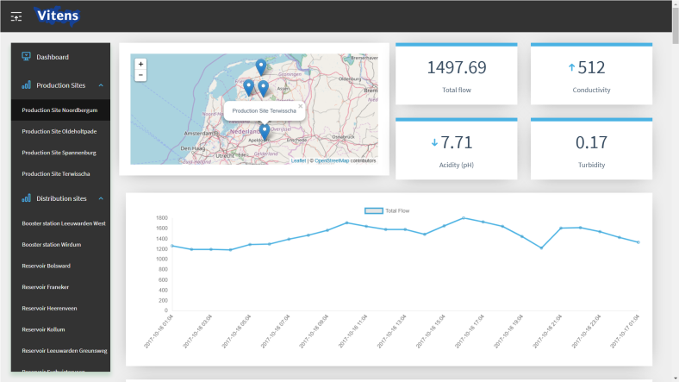
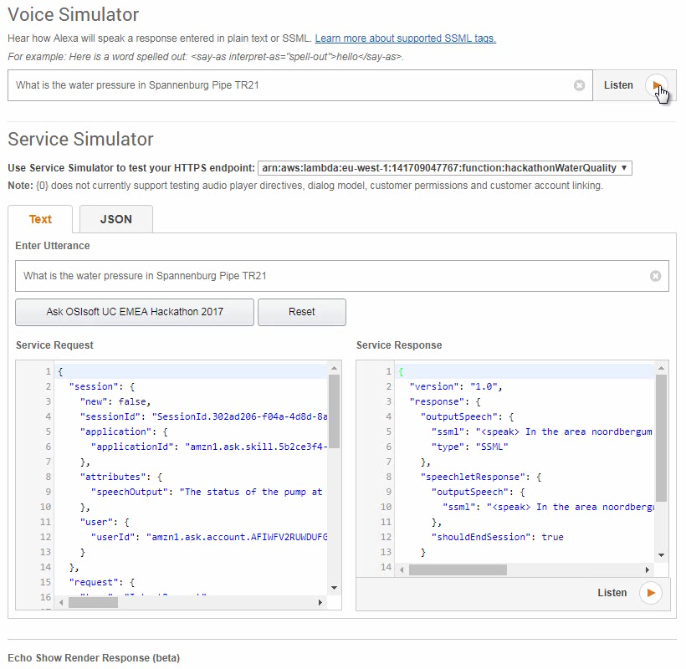
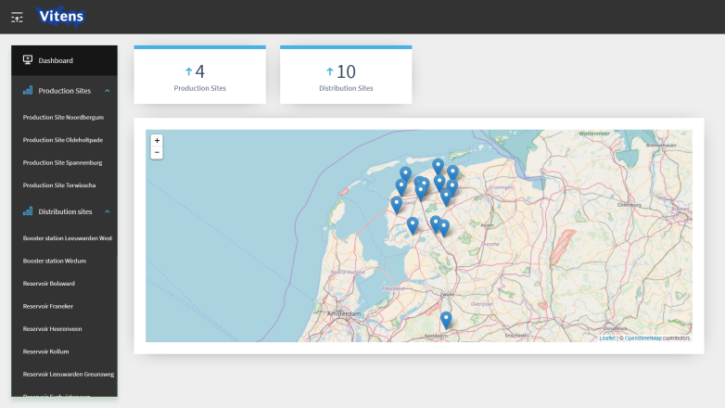
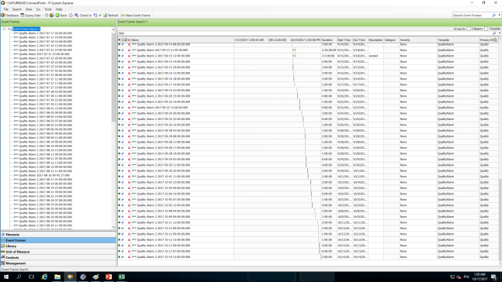
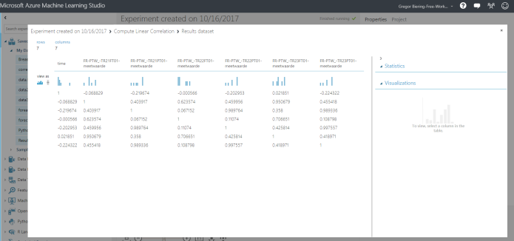
OSIsoft EMEA 2017 Hackathon event

Slide 2
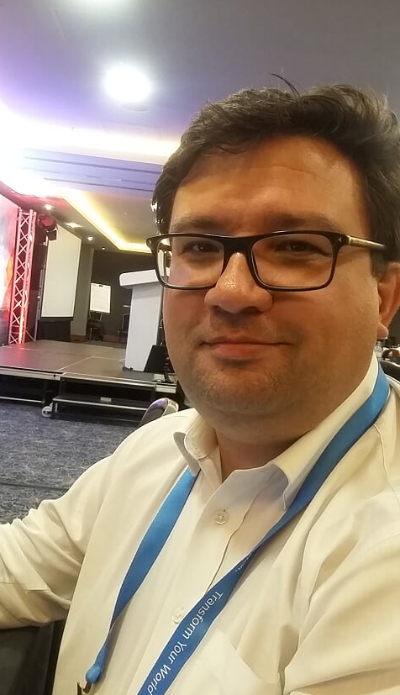

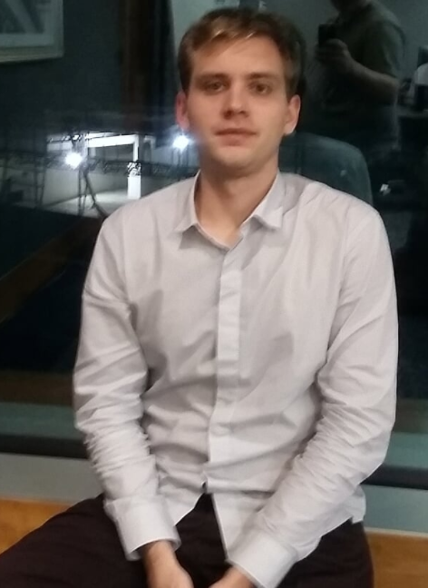

OSIsoft EMEA 2017 Hackathon event
„Objects on the presentation might look older than it appear“

Slide 3

Who are we?
Marek
Data Plumber
Jakub
Coder
Alexa
„her“
Przemyslaw
Coder
Gregor
The other
Notes:
The graphical treatment on the left indicates how ConnectPoint works alongside other project partners – without actually overstating this. Collaboration is an important point to make but should not detract from the specific work that ConnectPoint delivered to help Veolia establish a digitally advanced heating network across Warsaw – the largest implementation of its kind in Poland.
This intelligent network delivers a number of improvements, fully integrated across all operations. All of Veolia’s staff now have actionable insight and proactive intelligence at their fingertips. In addition, the ConnectPoint system integrates Veolia more closely with Warsaw’s heat and cogeneration units – a critical element in optimizing the city-wide heating network.
WHAT WAS DELIVERED:
Full integration
A fundamental element of this intelligent heating network is the Central Data Repository (CDR, based on OSIsoft PI system, the world-wide leading operation and business analytics platform for the utility sector). The CDR has enabled the convergence of IT and OT systems, with automated key network processes and real-time data access, analysis, and visualization. This has centralized network insight for all Veolia’s staff, as well as forged a closer connection with energy producers, distributors, and consumers.
Holistic operations
The CDR system collects, processes, and visualizes network data on the ConnectPoint-built Dispatcher Operations Dashboard within a centralized control room. This is a holistic analysis tool accessible for all Veolia staff, helping them to monitor network parameters, forecast heating requirements, and propose and allow the execution of the most efficient heat purchasing and delivery. And, if there is a technical issue anywhere on the network, the CDR is integrated with a tool that makes the optimum configuration changes to ensure continued high-quality heating delivery.
Actionable insight
Through the Dispatcher Operations Dashboard, fieldworkers, engineers, and dispatchers can access all data from telemetric and digital control systems across the network in real-time to clearly understand current demand as well as likely remotely impact on operational hardware such as pumping stations and devices located in heat chambers. This helps Veolia to meet the EU’s tight restrictions on energy losses and efficiency improvement.
Proactive intelligence
As the core platform, the CDR fully integrates with other related data sources. Using machine-learning, predictive analytics, and BI-powered forecasting tools, it provides intelligent supply-and-demand models and impact analysis for changeable conditions to
optimize the heating network at all times. This provides Veolia staff with new levels of insight so they can make more proactive decisions enabling the network to deliver a high-quality and efficient heating service.
Remote monitoring
More efficient and cost-effective management of pumping stations with remote monitoring, allowing for the redistribution of human resources to higher value operations.

Slide 4



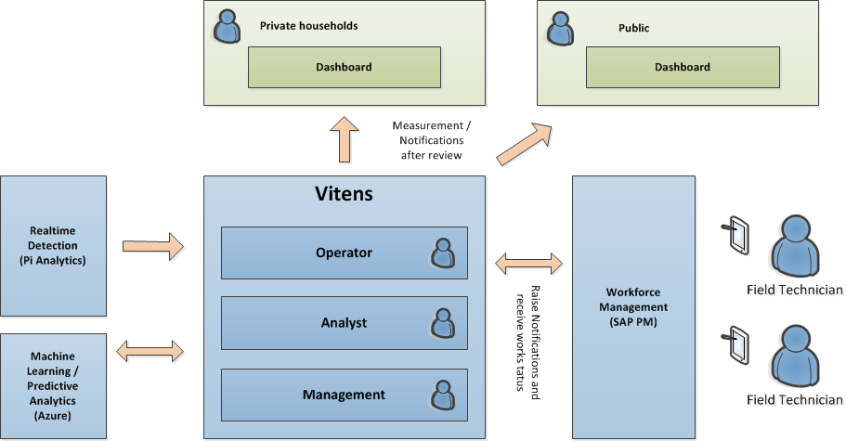
The challenge
Provide our of their future
A connected system that combines realtime data, detects anomalies and provide this to the right person to enable the right action.
Notes:
The graphical treatment on the left indicates how ConnectPoint works alongside other project partners – without actually overstating this. Collaboration is an important point to make but should not detract from the specific work that ConnectPoint delivered to help Veolia establish a digitally advanced heating network across Warsaw – the largest implementation of its kind in Poland.
This intelligent network delivers a number of improvements, fully integrated across all operations. All of Veolia’s staff now have actionable insight and proactive intelligence at their fingertips. In addition, the ConnectPoint system integrates Veolia more closely with Warsaw’s heat and cogeneration units – a critical element in optimizing the city-wide heating network.
WHAT WAS DELIVERED:
Full integration
A fundamental element of this intelligent heating network is the Central Data Repository (CDR, based on OSIsoft PI system, the world-wide leading operation and business analytics platform for the utility sector). The CDR has enabled the convergence of IT and OT systems, with automated key network processes and real-time data access, analysis, and visualization. This has centralized network insight for all Veolia’s staff, as well as forged a closer connection with energy producers, distributors, and consumers.
Holistic operations
The CDR system collects, processes, and visualizes network data on the ConnectPoint-built Dispatcher Operations Dashboard within a centralized control room. This is a holistic analysis tool accessible for all Veolia staff, helping them to monitor network parameters, forecast heating requirements, and propose and allow the execution of the most efficient heat purchasing and delivery. And, if there is a technical issue anywhere on the network, the CDR is integrated with a tool that makes the optimum configuration changes to ensure continued high-quality heating delivery.
Actionable insight
Through the Dispatcher Operations Dashboard, fieldworkers, engineers, and dispatchers can access all data from telemetric and digital control systems across the network in real-time to clearly understand current demand as well as likely remotely impact on operational hardware such as pumping stations and devices located in heat chambers. This helps Veolia to meet the EU’s tight restrictions on energy losses and efficiency improvement.
Proactive intelligence
As the core platform, the CDR fully integrates with other related data sources. Using machine-learning, predictive analytics, and BI-powered forecasting tools, it provides intelligent supply-and-demand models and impact analysis for changeable conditions to
optimize the heating network at all times. This provides Veolia staff with new levels of insight so they can make more proactive decisions enabling the network to deliver a high-quality and efficient heating service.
Remote monitoring
More efficient and cost-effective management of pumping stations with remote monitoring, allowing for the redistribution of human resources to higher value operations.

Slide 5
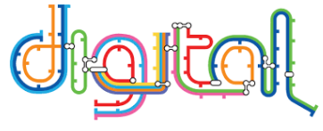
Provide our of their future
When the data indicates an issue that can cause a problem, it is assigned to the right work force and affected parties are notified if required.
Interventions are performed to resolve the issue.
Analytics in real time identify anomalies. Machine learning analytics predicts by correlating signals and past experience
Solutions are recorded. Outage and incidents are prevented and private households dissatisfaction eliminated
Data is acquired and transmitted to a central location
Notes:
The graphical treatment on the left indicates how ConnectPoint works alongside other project partners – without actually overstating this. Collaboration is an important point to make but should not detract from the specific work that ConnectPoint delivered to help Veolia establish a digitally advanced heating network across Warsaw – the largest implementation of its kind in Poland.
This intelligent network delivers a number of improvements, fully integrated across all operations. All of Veolia’s staff now have actionable insight and proactive intelligence at their fingertips. In addition, the ConnectPoint system integrates Veolia more closely with Warsaw’s heat and cogeneration units – a critical element in optimizing the city-wide heating network.
WHAT WAS DELIVERED:
Full integration
A fundamental element of this intelligent heating network is the Central Data Repository (CDR, based on OSIsoft PI system, the world-wide leading operation and business analytics platform for the utility sector). The CDR has enabled the convergence of IT and OT systems, with automated key network processes and real-time data access, analysis, and visualization. This has centralized network insight for all Veolia’s staff, as well as forged a closer connection with energy producers, distributors, and consumers.
Holistic operations
The CDR system collects, processes, and visualizes network data on the ConnectPoint-built Dispatcher Operations Dashboard within a centralized control room. This is a holistic analysis tool accessible for all Veolia staff, helping them to monitor network parameters, forecast heating requirements, and propose and allow the execution of the most efficient heat purchasing and delivery. And, if there is a technical issue anywhere on the network, the CDR is integrated with a tool that makes the optimum configuration changes to ensure continued high-quality heating delivery.
Actionable insight
Through the Dispatcher Operations Dashboard, fieldworkers, engineers, and dispatchers can access all data from telemetric and digital control systems across the network in real-time to clearly understand current demand as well as likely remotely impact on operational hardware such as pumping stations and devices located in heat chambers. This helps Veolia to meet the EU’s tight restrictions on energy losses and efficiency improvement.
Proactive intelligence
As the core platform, the CDR fully integrates with other related data sources. Using machine-learning, predictive analytics, and BI-powered forecasting tools, it provides intelligent supply-and-demand models and impact analysis for changeable conditions to
optimize the heating network at all times. This provides Veolia staff with new levels of insight so they can make more proactive decisions enabling the network to deliver a high-quality and efficient heating service.
Remote monitoring
More efficient and cost-effective management of pumping stations with remote monitoring, allowing for the redistribution of human resources to higher value operations.

Slide 6

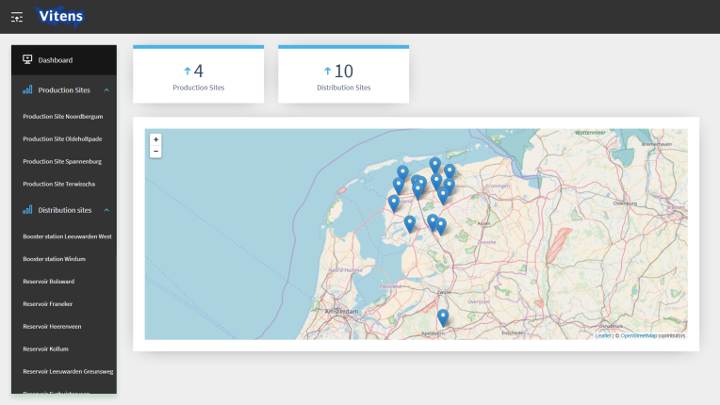

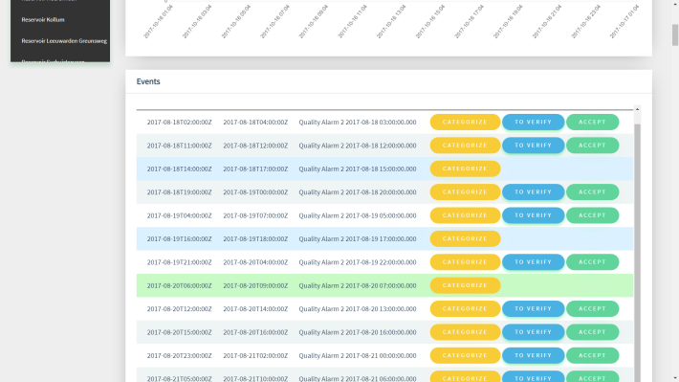

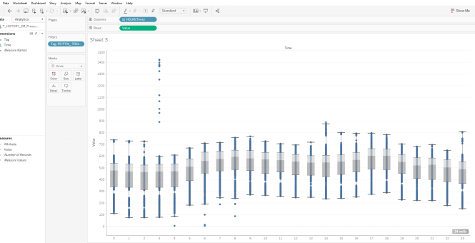
What we did
Notes:
The graphical treatment on the left indicates how ConnectPoint works alongside other project partners – without actually overstating this. Collaboration is an important point to make but should not detract from the specific work that ConnectPoint delivered to help Veolia establish a digitally advanced heating network across Warsaw – the largest implementation of its kind in Poland.
This intelligent network delivers a number of improvements, fully integrated across all operations. All of Veolia’s staff now have actionable insight and proactive intelligence at their fingertips. In addition, the ConnectPoint system integrates Veolia more closely with Warsaw’s heat and cogeneration units – a critical element in optimizing the city-wide heating network.
WHAT WAS DELIVERED:
Full integration
A fundamental element of this intelligent heating network is the Central Data Repository (CDR, based on OSIsoft PI system, the world-wide leading operation and business analytics platform for the utility sector). The CDR has enabled the convergence of IT and OT systems, with automated key network processes and real-time data access, analysis, and visualization. This has centralized network insight for all Veolia’s staff, as well as forged a closer connection with energy producers, distributors, and consumers.
Holistic operations
The CDR system collects, processes, and visualizes network data on the ConnectPoint-built Dispatcher Operations Dashboard within a centralized control room. This is a holistic analysis tool accessible for all Veolia staff, helping them to monitor network parameters, forecast heating requirements, and propose and allow the execution of the most efficient heat purchasing and delivery. And, if there is a technical issue anywhere on the network, the CDR is integrated with a tool that makes the optimum configuration changes to ensure continued high-quality heating delivery.
Actionable insight
Through the Dispatcher Operations Dashboard, fieldworkers, engineers, and dispatchers can access all data from telemetric and digital control systems across the network in real-time to clearly understand current demand as well as likely remotely impact on operational hardware such as pumping stations and devices located in heat chambers. This helps Veolia to meet the EU’s tight restrictions on energy losses and efficiency improvement.
Proactive intelligence
As the core platform, the CDR fully integrates with other related data sources. Using machine-learning, predictive analytics, and BI-powered forecasting tools, it provides intelligent supply-and-demand models and impact analysis for changeable conditions to
optimize the heating network at all times. This provides Veolia staff with new levels of insight so they can make more proactive decisions enabling the network to deliver a high-quality and efficient heating service.
Remote monitoring
More efficient and cost-effective management of pumping stations with remote monitoring, allowing for the redistribution of human resources to higher value operations.

Slide 7
Used technologies
PI AssetFramework
Analysis
EventFrames
Webtechnologies
PI Web API
Realtime data (channels/websockets)
Batch queries
EventFrames (fetch and acknowledge)
Vue.js + Vuestic
Look and feel
Chart.js
Charting total flows
Leaflet.js + OpenStreetMaps
Displaying location of sites
Data Analytics
Tableau Desktop
Microsoft Azure Machine Learning Studio
SQL
PI OLEDB
Extended Userexperience
Alexa
Alexa Skills Kit
AWS Lambda Function (Node.js)
Notes:
The graphical treatment on the left indicates how ConnectPoint works alongside other project partners – without actually overstating this. Collaboration is an important point to make but should not detract from the specific work that ConnectPoint delivered to help Veolia establish a digitally advanced heating network across Warsaw – the largest implementation of its kind in Poland.
This intelligent network delivers a number of improvements, fully integrated across all operations. All of Veolia’s staff now have actionable insight and proactive intelligence at their fingertips. In addition, the ConnectPoint system integrates Veolia more closely with Warsaw’s heat and cogeneration units – a critical element in optimizing the city-wide heating network.
WHAT WAS DELIVERED:
Full integration
A fundamental element of this intelligent heating network is the Central Data Repository (CDR, based on OSIsoft PI system, the world-wide leading operation and business analytics platform for the utility sector). The CDR has enabled the convergence of IT and OT systems, with automated key network processes and real-time data access, analysis, and visualization. This has centralized network insight for all Veolia’s staff, as well as forged a closer connection with energy producers, distributors, and consumers.
Holistic operations
The CDR system collects, processes, and visualizes network data on the ConnectPoint-built Dispatcher Operations Dashboard within a centralized control room. This is a holistic analysis tool accessible for all Veolia staff, helping them to monitor network parameters, forecast heating requirements, and propose and allow the execution of the most efficient heat purchasing and delivery. And, if there is a technical issue anywhere on the network, the CDR is integrated with a tool that makes the optimum configuration changes to ensure continued high-quality heating delivery.
Actionable insight
Through the Dispatcher Operations Dashboard, fieldworkers, engineers, and dispatchers can access all data from telemetric and digital control systems across the network in real-time to clearly understand current demand as well as likely remotely impact on operational hardware such as pumping stations and devices located in heat chambers. This helps Veolia to meet the EU’s tight restrictions on energy losses and efficiency improvement.
Proactive intelligence
As the core platform, the CDR fully integrates with other related data sources. Using machine-learning, predictive analytics, and BI-powered forecasting tools, it provides intelligent supply-and-demand models and impact analysis for changeable conditions to
optimize the heating network at all times. This provides Veolia staff with new levels of insight so they can make more proactive decisions enabling the network to deliver a high-quality and efficient heating service.
Remote monitoring
More efficient and cost-effective management of pumping stations with remote monitoring, allowing for the redistribution of human resources to higher value operations.

Slide 8
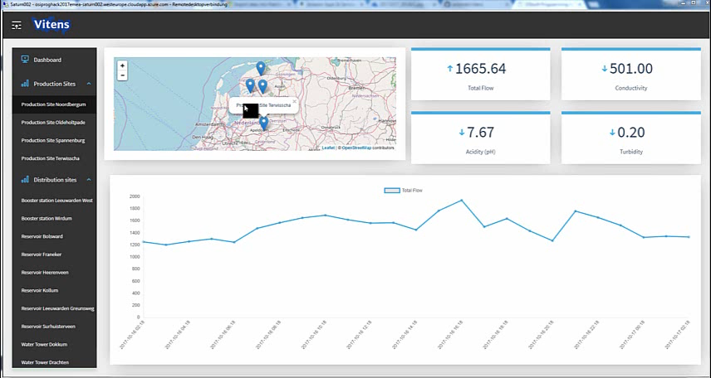
Dashboard
Notes:
The graphical treatment on the left indicates how ConnectPoint works alongside other project partners – without actually overstating this. Collaboration is an important point to make but should not detract from the specific work that ConnectPoint delivered to help Veolia establish a digitally advanced heating network across Warsaw – the largest implementation of its kind in Poland.
This intelligent network delivers a number of improvements, fully integrated across all operations. All of Veolia’s staff now have actionable insight and proactive intelligence at their fingertips. In addition, the ConnectPoint system integrates Veolia more closely with Warsaw’s heat and cogeneration units – a critical element in optimizing the city-wide heating network.
WHAT WAS DELIVERED:
Full integration
A fundamental element of this intelligent heating network is the Central Data Repository (CDR, based on OSIsoft PI system, the world-wide leading operation and business analytics platform for the utility sector). The CDR has enabled the convergence of IT and OT systems, with automated key network processes and real-time data access, analysis, and visualization. This has centralized network insight for all Veolia’s staff, as well as forged a closer connection with energy producers, distributors, and consumers.
Holistic operations
The CDR system collects, processes, and visualizes network data on the ConnectPoint-built Dispatcher Operations Dashboard within a centralized control room. This is a holistic analysis tool accessible for all Veolia staff, helping them to monitor network parameters, forecast heating requirements, and propose and allow the execution of the most efficient heat purchasing and delivery. And, if there is a technical issue anywhere on the network, the CDR is integrated with a tool that makes the optimum configuration changes to ensure continued high-quality heating delivery.
Actionable insight
Through the Dispatcher Operations Dashboard, fieldworkers, engineers, and dispatchers can access all data from telemetric and digital control systems across the network in real-time to clearly understand current demand as well as likely remotely impact on operational hardware such as pumping stations and devices located in heat chambers. This helps Veolia to meet the EU’s tight restrictions on energy losses and efficiency improvement.
Proactive intelligence
As the core platform, the CDR fully integrates with other related data sources. Using machine-learning, predictive analytics, and BI-powered forecasting tools, it provides intelligent supply-and-demand models and impact analysis for changeable conditions to
optimize the heating network at all times. This provides Veolia staff with new levels of insight so they can make more proactive decisions enabling the network to deliver a high-quality and efficient heating service.
Remote monitoring
More efficient and cost-effective management of pumping stations with remote monitoring, allowing for the redistribution of human resources to higher value operations.

Slide 9
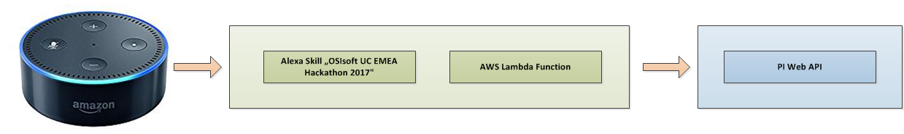
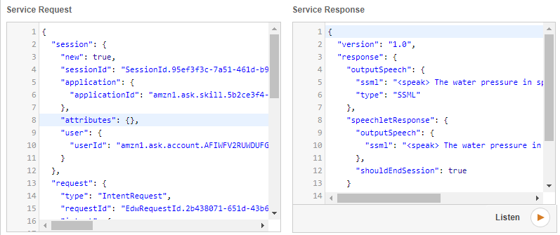
Alexa
Notes:
The graphical treatment on the left indicates how ConnectPoint works alongside other project partners – without actually overstating this. Collaboration is an important point to make but should not detract from the specific work that ConnectPoint delivered to help Veolia establish a digitally advanced heating network across Warsaw – the largest implementation of its kind in Poland.
This intelligent network delivers a number of improvements, fully integrated across all operations. All of Veolia’s staff now have actionable insight and proactive intelligence at their fingertips. In addition, the ConnectPoint system integrates Veolia more closely with Warsaw’s heat and cogeneration units – a critical element in optimizing the city-wide heating network.
WHAT WAS DELIVERED:
Full integration
A fundamental element of this intelligent heating network is the Central Data Repository (CDR, based on OSIsoft PI system, the world-wide leading operation and business analytics platform for the utility sector). The CDR has enabled the convergence of IT and OT systems, with automated key network processes and real-time data access, analysis, and visualization. This has centralized network insight for all Veolia’s staff, as well as forged a closer connection with energy producers, distributors, and consumers.
Holistic operations
The CDR system collects, processes, and visualizes network data on the ConnectPoint-built Dispatcher Operations Dashboard within a centralized control room. This is a holistic analysis tool accessible for all Veolia staff, helping them to monitor network parameters, forecast heating requirements, and propose and allow the execution of the most efficient heat purchasing and delivery. And, if there is a technical issue anywhere on the network, the CDR is integrated with a tool that makes the optimum configuration changes to ensure continued high-quality heating delivery.
Actionable insight
Through the Dispatcher Operations Dashboard, fieldworkers, engineers, and dispatchers can access all data from telemetric and digital control systems across the network in real-time to clearly understand current demand as well as likely remotely impact on operational hardware such as pumping stations and devices located in heat chambers. This helps Veolia to meet the EU’s tight restrictions on energy losses and efficiency improvement.
Proactive intelligence
As the core platform, the CDR fully integrates with other related data sources. Using machine-learning, predictive analytics, and BI-powered forecasting tools, it provides intelligent supply-and-demand models and impact analysis for changeable conditions to
optimize the heating network at all times. This provides Veolia staff with new levels of insight so they can make more proactive decisions enabling the network to deliver a high-quality and efficient heating service.
Remote monitoring
More efficient and cost-effective management of pumping stations with remote monitoring, allowing for the redistribution of human resources to higher value operations.

Slide 10
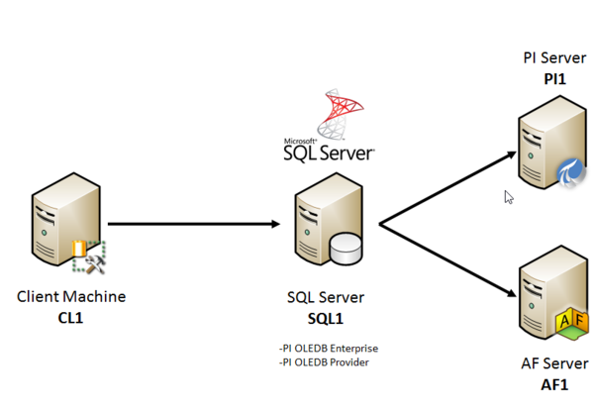
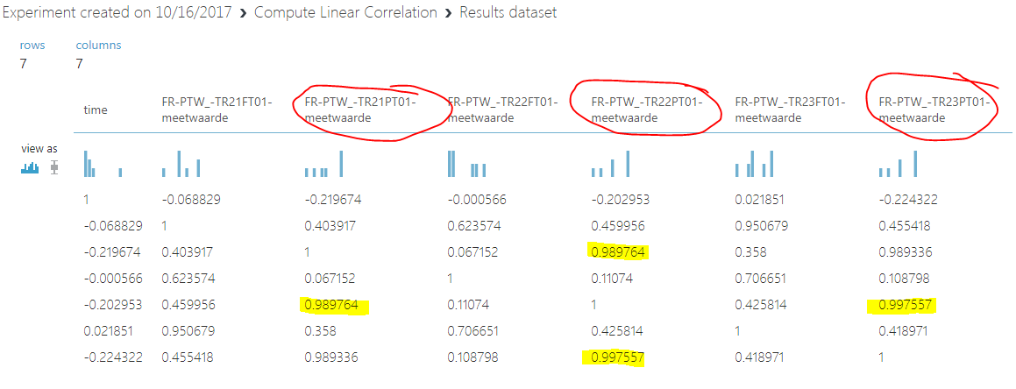
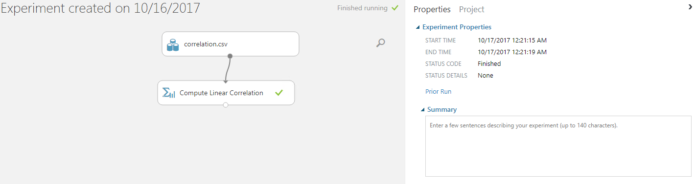
Data Analytics (Cloud)
Using Data Extracts via PI OLEDB and visualizing the data with Tableau and experimenting with Microsoft Azure Machine Learning Studio
Notes:
The graphical treatment on the left indicates how ConnectPoint works alongside other project partners – without actually overstating this. Collaboration is an important point to make but should not detract from the specific work that ConnectPoint delivered to help Veolia establish a digitally advanced heating network across Warsaw – the largest implementation of its kind in Poland.
This intelligent network delivers a number of improvements, fully integrated across all operations. All of Veolia’s staff now have actionable insight and proactive intelligence at their fingertips. In addition, the ConnectPoint system integrates Veolia more closely with Warsaw’s heat and cogeneration units – a critical element in optimizing the city-wide heating network.
WHAT WAS DELIVERED:
Full integration
A fundamental element of this intelligent heating network is the Central Data Repository (CDR, based on OSIsoft PI system, the world-wide leading operation and business analytics platform for the utility sector). The CDR has enabled the convergence of IT and OT systems, with automated key network processes and real-time data access, analysis, and visualization. This has centralized network insight for all Veolia’s staff, as well as forged a closer connection with energy producers, distributors, and consumers.
Holistic operations
The CDR system collects, processes, and visualizes network data on the ConnectPoint-built Dispatcher Operations Dashboard within a centralized control room. This is a holistic analysis tool accessible for all Veolia staff, helping them to monitor network parameters, forecast heating requirements, and propose and allow the execution of the most efficient heat purchasing and delivery. And, if there is a technical issue anywhere on the network, the CDR is integrated with a tool that makes the optimum configuration changes to ensure continued high-quality heating delivery.
Actionable insight
Through the Dispatcher Operations Dashboard, fieldworkers, engineers, and dispatchers can access all data from telemetric and digital control systems across the network in real-time to clearly understand current demand as well as likely remotely impact on operational hardware such as pumping stations and devices located in heat chambers. This helps Veolia to meet the EU’s tight restrictions on energy losses and efficiency improvement.
Proactive intelligence
As the core platform, the CDR fully integrates with other related data sources. Using machine-learning, predictive analytics, and BI-powered forecasting tools, it provides intelligent supply-and-demand models and impact analysis for changeable conditions to
optimize the heating network at all times. This provides Veolia staff with new levels of insight so they can make more proactive decisions enabling the network to deliver a high-quality and efficient heating service.
Remote monitoring
More efficient and cost-effective management of pumping stations with remote monitoring, allowing for the redistribution of human resources to higher value operations.

Slide 11

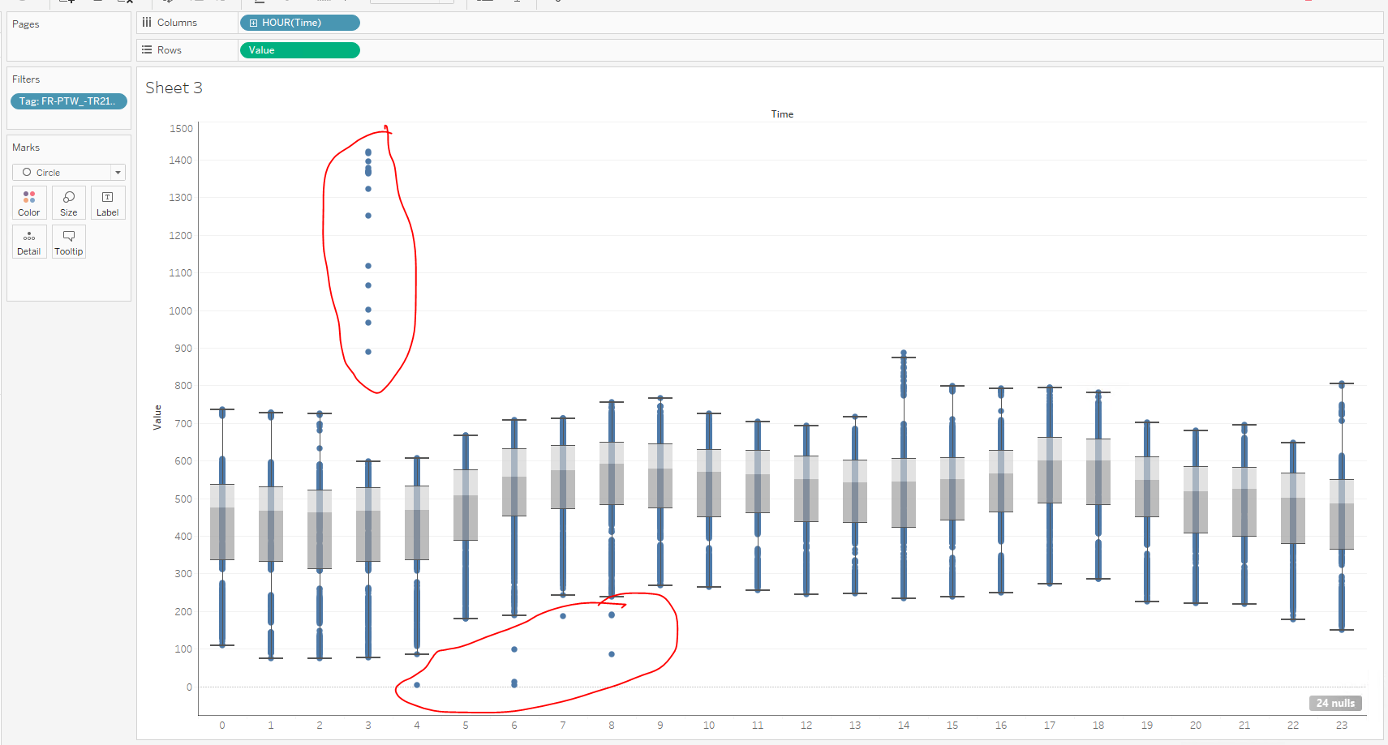
Data Analytics (Tableau)
Using Data Extracts via PI OLEDB and visualizing the data with Tableau and experimenting with Microsoft Azure Machine Learning Studio
Notes:
The graphical treatment on the left indicates how ConnectPoint works alongside other project partners – without actually overstating this. Collaboration is an important point to make but should not detract from the specific work that ConnectPoint delivered to help Veolia establish a digitally advanced heating network across Warsaw – the largest implementation of its kind in Poland.
This intelligent network delivers a number of improvements, fully integrated across all operations. All of Veolia’s staff now have actionable insight and proactive intelligence at their fingertips. In addition, the ConnectPoint system integrates Veolia more closely with Warsaw’s heat and cogeneration units – a critical element in optimizing the city-wide heating network.
WHAT WAS DELIVERED:
Full integration
A fundamental element of this intelligent heating network is the Central Data Repository (CDR, based on OSIsoft PI system, the world-wide leading operation and business analytics platform for the utility sector). The CDR has enabled the convergence of IT and OT systems, with automated key network processes and real-time data access, analysis, and visualization. This has centralized network insight for all Veolia’s staff, as well as forged a closer connection with energy producers, distributors, and consumers.
Holistic operations
The CDR system collects, processes, and visualizes network data on the ConnectPoint-built Dispatcher Operations Dashboard within a centralized control room. This is a holistic analysis tool accessible for all Veolia staff, helping them to monitor network parameters, forecast heating requirements, and propose and allow the execution of the most efficient heat purchasing and delivery. And, if there is a technical issue anywhere on the network, the CDR is integrated with a tool that makes the optimum configuration changes to ensure continued high-quality heating delivery.
Actionable insight
Through the Dispatcher Operations Dashboard, fieldworkers, engineers, and dispatchers can access all data from telemetric and digital control systems across the network in real-time to clearly understand current demand as well as likely remotely impact on operational hardware such as pumping stations and devices located in heat chambers. This helps Veolia to meet the EU’s tight restrictions on energy losses and efficiency improvement.
Proactive intelligence
As the core platform, the CDR fully integrates with other related data sources. Using machine-learning, predictive analytics, and BI-powered forecasting tools, it provides intelligent supply-and-demand models and impact analysis for changeable conditions to
optimize the heating network at all times. This provides Veolia staff with new levels of insight so they can make more proactive decisions enabling the network to deliver a high-quality and efficient heating service.
Remote monitoring
More efficient and cost-effective management of pumping stations with remote monitoring, allowing for the redistribution of human resources to higher value operations.

Slide 12
How this will help f
Better overview and workflow by having systems connected
Using existing powerfull tools to prevent implementation of things that already exists (e.g. Cortana Intelligence Gallery)
Enabling easy data access by using Tableau for data exploration
Interaction with the system in new way (Alexa)
Saving costs predicting events faster and assigning field forces faster

Slide 13
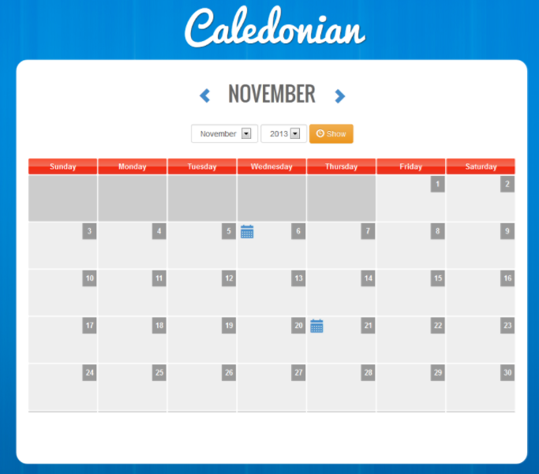
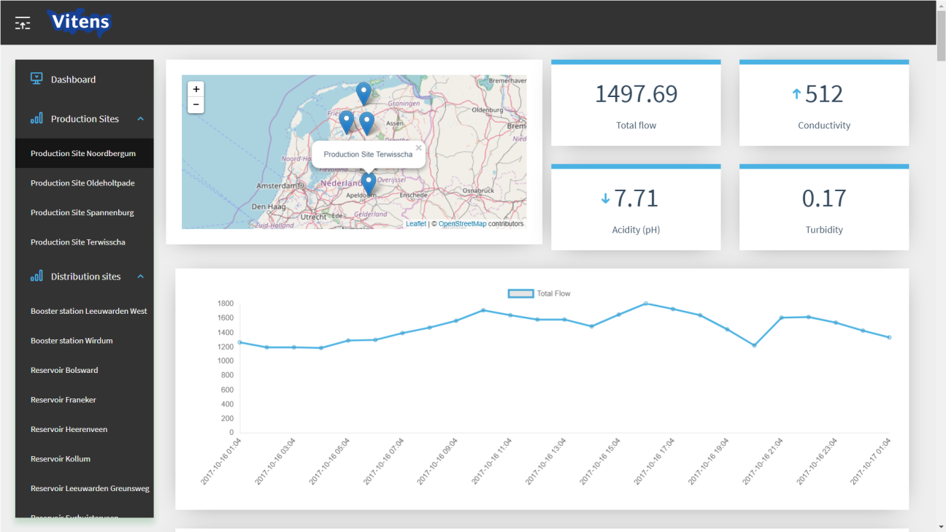
Last minute idea
+
By categorizing issues / anomalies not just to operative events but public events too (e.g. football, vacation) is it possible to predict effects by just checking the calendar?

Slide 14

E.ON Climate & Renewables - ConnectPoint
E.ON is an international, privately-owned energy supplier focused on 3 areas:
Renewables
Energy networks
Customer solutions
It operates in over 30 countries and serves over 33 million customers.
The Company employs above 50 000 people world-wide and annually achieves revenues above 100 billions Euro
E.ON Climate & Renewables (EC&R), headquartered in Essen, Germany, is responsible for E.ON’s industrial-scale renewable energy activities.
EC&R develops, builds and operates large renewable energy assets in Europe and North America.
ConnectPoint is a Software vendor and System Integrator specialized in Utilities & Industry sector
The company is present in Poland and Germany with the team of experienced professional in IT/OT integration and SW development
ConnectPoint started co-operation with E.ON Climate & Renewables in 2013 and since that time the company conducted above 20 projects in areas like
Custom Software development
System Integration in IT/OT area
Business Intelligence applications development (e.g. OSIsoft PI)
Notes:
The graphical treatment on the left indicates how ConnectPoint works alongside other project partners – without actually overstating this. Collaboration is an important point to make but should not detract from the specific work that ConnectPoint delivered to help Veolia establish a digitally advanced heating network across Warsaw – the largest implementation of its kind in Poland.
This intelligent network delivers a number of improvements, fully integrated across all operations. All of Veolia’s staff now have actionable insight and proactive intelligence at their fingertips. In addition, the ConnectPoint system integrates Veolia more closely with Warsaw’s heat and cogeneration units – a critical element in optimizing the city-wide heating network.
WHAT WAS DELIVERED:
Full integration
A fundamental element of this intelligent heating network is the Central Data Repository (CDR, based on OSIsoft PI system, the world-wide leading operation and business analytics platform for the utility sector). The CDR has enabled the convergence of IT and OT systems, with automated key network processes and real-time data access, analysis, and visualization. This has centralized network insight for all Veolia’s staff, as well as forged a closer connection with energy producers, distributors, and consumers.
Holistic operations
The CDR system collects, processes, and visualizes network data on the ConnectPoint-built Dispatcher Operations Dashboard within a centralized control room. This is a holistic analysis tool accessible for all Veolia staff, helping them to monitor network parameters, forecast heating requirements, and propose and allow the execution of the most efficient heat purchasing and delivery. And, if there is a technical issue anywhere on the network, the CDR is integrated with a tool that makes the optimum configuration changes to ensure continued high-quality heating delivery.
Actionable insight
Through the Dispatcher Operations Dashboard, fieldworkers, engineers, and dispatchers can access all data from telemetric and digital control systems across the network in real-time to clearly understand current demand as well as likely remotely impact on operational hardware such as pumping stations and devices located in heat chambers. This helps Veolia to meet the EU’s tight restrictions on energy losses and efficiency improvement.
Proactive intelligence
As the core platform, the CDR fully integrates with other related data sources. Using machine-learning, predictive analytics, and BI-powered forecasting tools, it provides intelligent supply-and-demand models and impact analysis for changeable conditions to
optimize the heating network at all times. This provides Veolia staff with new levels of insight so they can make more proactive decisions enabling the network to deliver a high-quality and efficient heating service.
Remote monitoring
More efficient and cost-effective management of pumping stations with remote monitoring, allowing for the redistribution of human resources to higher value operations.

Slide 15

Find out more.
If you would like to find out more about how ConnectPoint can help transform your utility service with intelligent network capability, get in touch with konrad.kazmierowski@connectpoint.pl

